Slide 1
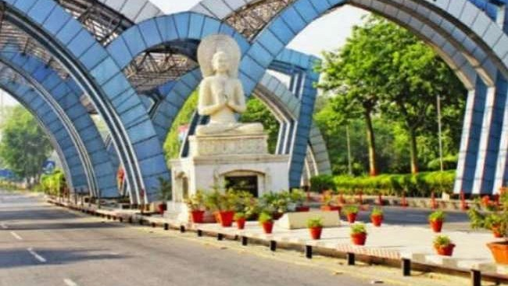
Finding and Clustering Neighborhoods in Noida based on the availability of necessary/luxury commodities
COURSERA CAPSTONE
By Yash Singhal

Slide 2
Background
Noida is an organized and developed city in the National Capital Region of India, adjacent to the Capital, Delhi. It is composed of multiple parks, shopping complexes, offices, residential complexes, schools, local markets and general recreational spots.
With a population of 600 thousand people, it is one of the large cities of India and plays an important role in the Region’s development as it is home to multiple multinationals such as Samsung, Adobe, CSC, HP, HCL and many more.

Slide 3
Business Problem
I saw during the Current CoronaVirus Pandemic that groups of residential sectors are and were locked down to contain the spread of the Virus.
In some cities, areas are being boxed off and "fortified" to contain the spread of the Virus.
This presented the problem that there were sectors/groups of residential sectors without certain types of shops or amenities present, forcing the people to go out of their sectors to get said amenities
The Government and the Noida Authority would definitely want to know these locations so they could better develop these sectors and promote the building of the shops which are not there.

Slide 4
Idea
My idea is to cluster the sectors in Noida based on the availability of different types of shops/places in them.
I would cluster the sectors and try to analyse and identify sectors that lack the basic amenities or different types of shops/venues.

Slide 5

Target Audience
My Target audience is the Indian Government and the Noida Authority who would want to know which sectors need more development and work accordingly
Additionally, other people who are looking to buy a new house or open a shop can look into this data to choose a location where more amenities are available or choose a new store location where existing stores are less in number.

Slide 6
Data
List of Residential Sectors in Noida
GeoLocation of Residential Sectors in Noida
Places near each sector within a kilometer from the sector’s location(This is taken from the GeoLocation of the Sector which I have seen is generally at the center of the Sector)

Slide 7
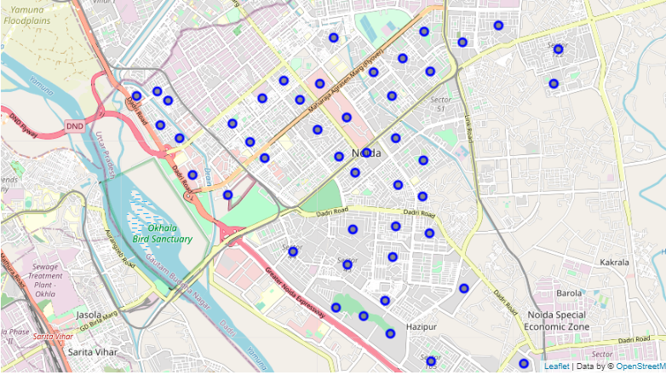
Unclustered Map
I map the different sectors in Noida on a Folium map

Slide 8
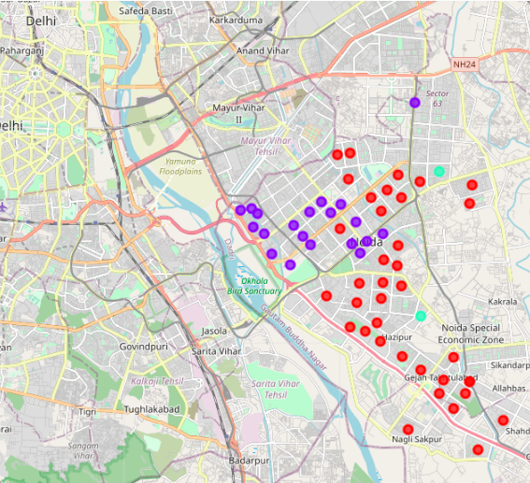
Clusters FOrmed
Blue cluster is the Highly Self Sufficient cluster
Red cluster is the Partly Self Sufficient cluster
Green cluster is the Barely Self Sufficient cluster.

Slide 9
Discussion
Based on the above analysis and my knowledge of Noida
Highly Self Sufficient sectors are those near the malls and shopping complexes and have a large variety and quantity of shops
Partly self sufficient ones including mine are mostly composed of residential complexes and have a smaller number of shops
Barely self sufficient ones are the ones on the outskirts of Noida and are recently formed, therefore don’t have many shops yet

Slide 10
My Suggestions
I would recommend the government to provide more resources to the Barely Self Sufficient sectors while developing shops there in the long term
For the Partly Self Sufficient Sectors, I would recommend the government to slowly increase the categories of venues available there and provide short term resources where needed.

